Slide 1
CSCI 111: Web Programming and Problem Solving
Lecture 2: Basics of HTML
Instructors:
Dr. Irina Dolzhikova,
Dr. Talgat Manglayev,
Dr. Syed Muhammad Umair Arif

Slide 2
Outline
Part I How does the web work
IP addresses and Domain names
DNS and getting domain
Client-Server Model
Websites and their architecture
HTML, CSS, JavaScript
Part II HTML
History of HTML
What is HTML
HTML document
HTML elements
HTML attributes
Document Object Model
HTML content Model
Some HTML tags
Escape characters
Useful HTML Resources

Slide 3
Part I
How does the web work

Slide 4
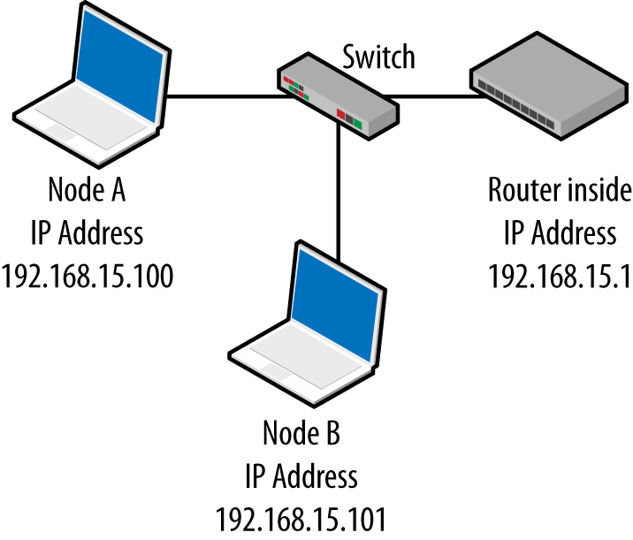
IP addresses
An Internet Protocol (IP) address is a unique identifier of a particular device on the Internet network
• PC, mobile, router, smart watch, TV
• Example: 178.91.253.180 [ Format is A.B.C.D ]
• IP addresses are mathematically produced and allocated by the Internet Assigned Numbers Authority (IANA)
• Types of IP addresses:
• public/private (global/local)
• static/dynamic

Slide 5
Domain Names
A domain name (or domain) is a text string (name) that’s associated with an IP address on the Internet.
• It is a unique name
• Easy to remember for human
• Example: nu.edu.kz, google.com
Types of Domain names:
• Root domain (top-level) – .com, .org, .kz, .ru,
• Subdomains (other levels) – google.com, nu.edu.kz, library.nu.edu.kz

Slide 6
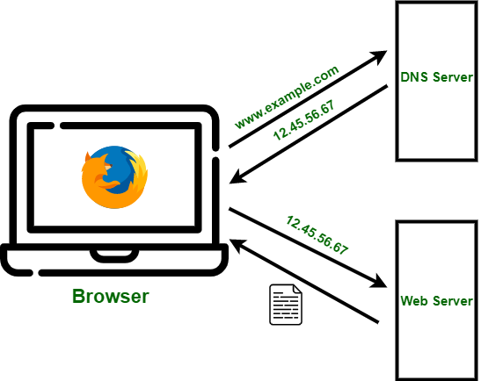
Domain Name System
The Domain Name System (DNS) is the hierarchical and decentralized naming system (database) used to identify computers reachable through the Internet or other Internet Protocol (IP) networks. [Wikipedia]
DNS is a “phonebook” or ”librarian” that converts domain names to IP
addresses
• nu.edu.kz --> 178.91.253.180
There are WHOIS services to lookup domains
• godaddy.com, hoster.kz, domaintoipconverter.com
The browser does a domain lookup for you

Slide 7
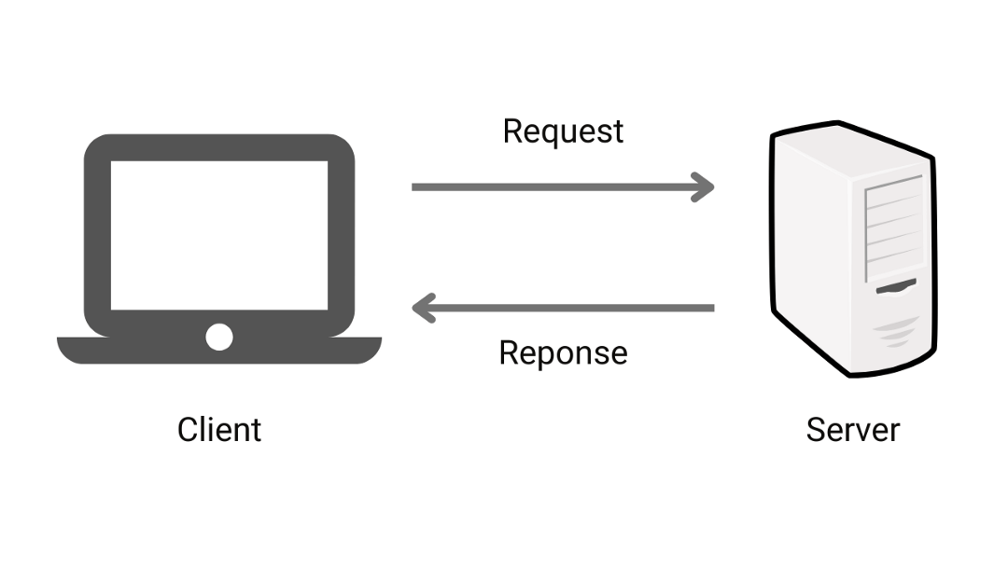

Client-Server Model

Slide 8

Websites
A website is a collection of web pages and related content that is identified by a common domain name and published on at least one web server with an IP address.
Domain: nu.edu.kz
IP address: 178.91.253.180
Web pages and their URLs:
• About Us - https://nu.edu.kz/about)
• Admission - https://nu.edu.kz/admissions
• Academics - https://nu.edu.kz/academics
• etc.

Slide 9
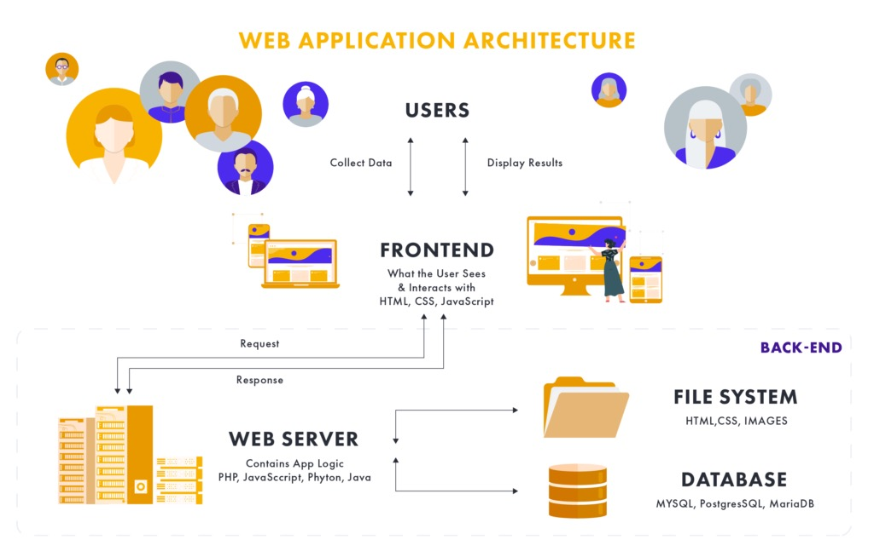
Website Architecture
A typical architecture of a website consists of:
Front-end part (user interface): HTML, CSS, JavaScript
Back-end part (business logic): Python, Java, PHP, etc.
Database: MySQL, PostgreSQL, MS SQL, Oracle
File System: images, audio, video, web pages
Front-end: what users see and interact with.
Back-end: the underlying system that supports
and processes user interactions.
A website can be static or dynamic depending on the content generated.

Slide 10



HTML, CSS, Javascript
Hyper-Text Markup Language (HTML) is the standard markup language for documents designed to be displayed in a web browser.
It describes the structure of the web page
Cascading Style Sheets (CSS) is a stylesheet language used to
describe the presentation of a document written in HTML.
It describes the style of the web page
JavaScript (JS) is a lightweight and interpreted programming (or
scripting) language for Web pages.
It adds interactivity to the web page

Slide 11

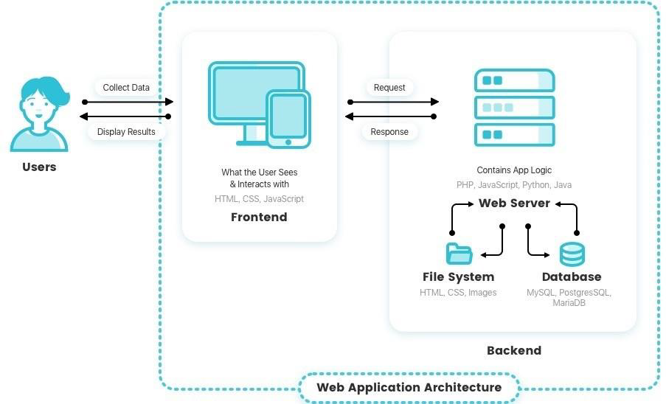
Introduction
•To access a website:
•Retrieve IP by Domain name (DNS)
•Access the Web server by IP
To serve the website:
•Implement Frontend: HTML, CSS, JS
Fig.1 -Before reaching the web server
Fig.2 -After reaching the web server

Slide 12



HTML, CSS, Javascript
Hyper-Text Markup Language (HTML) is the standard markup language for documents designed to be displayed in a web browser.
It describes the structure of the web page
Cascading Style Sheets (CSS) is a stylesheet language used to describe the presentation of a document written in HTML.
It describes the style of the web page
JavaScript (JS) is a lightweight and interpreted programming (or scripting) language for Web pages.
It adds behavior to the web page

Slide 13
Part II
HTML

Slide 14

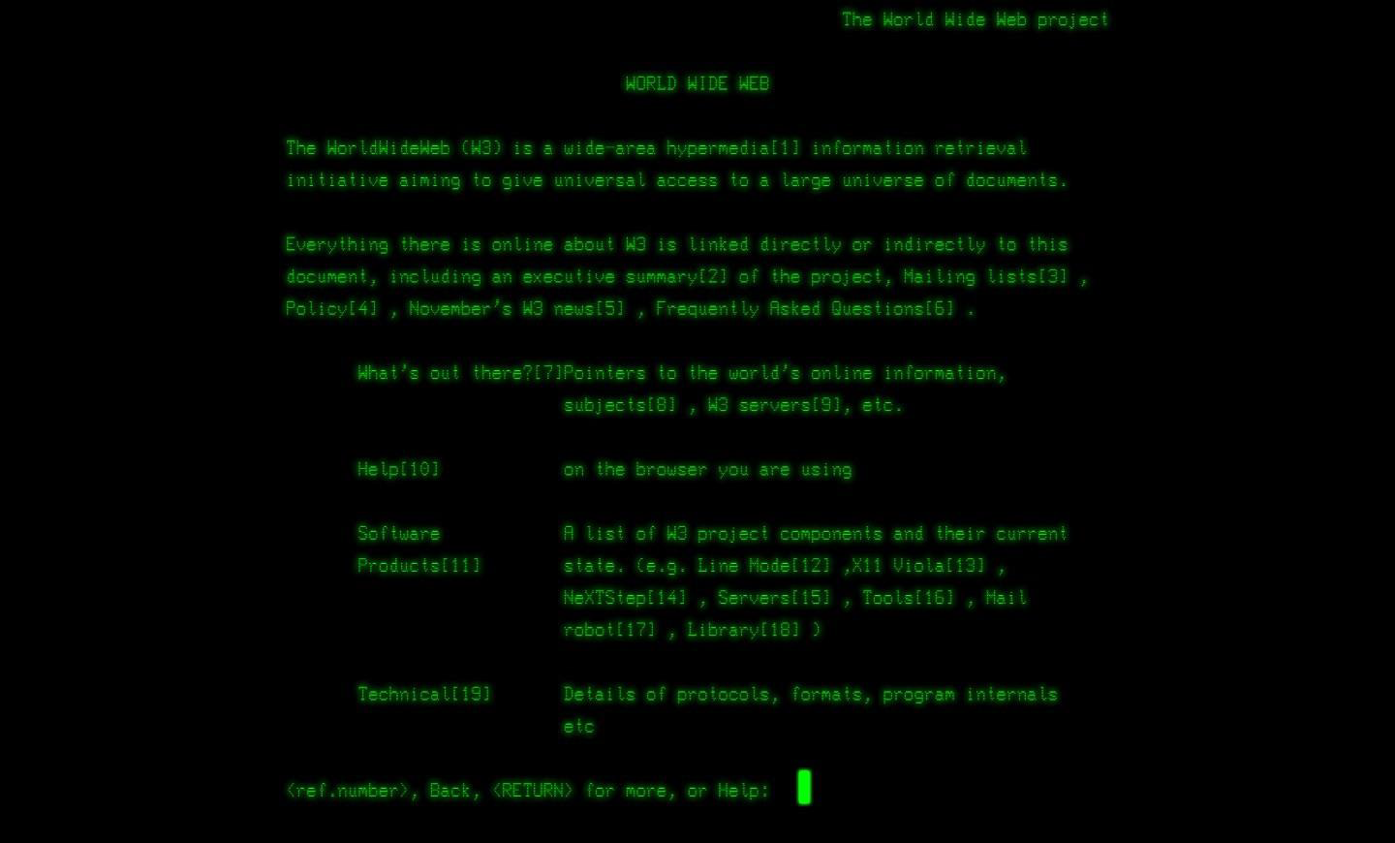
History of HTML
1989
Invention of WWW, HTTP, HTML
•Tim Berners-Lee (CERN)
Release of WWW software (CERN)
World Wide Web Consortium (W3C)
XHTML 1.0 based on XML (W3C)
WHATWG (Mozilla, Opera, and Apple)
HTML5 release (WHATWG, W3C)
HTML5.1, HTML5.2 and HTML5.3
2011
Sir Timothy John Berners-Lee
(8 June 1955), TimBL, is an English computer scientist, professor at MIT, and the director of the World Wide Web Consortium (W3C).
1993
1994
2000
http://info.cern.ch/ -home
2004
2007
2011

Slide 15
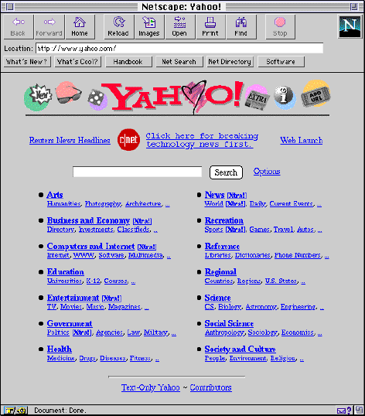

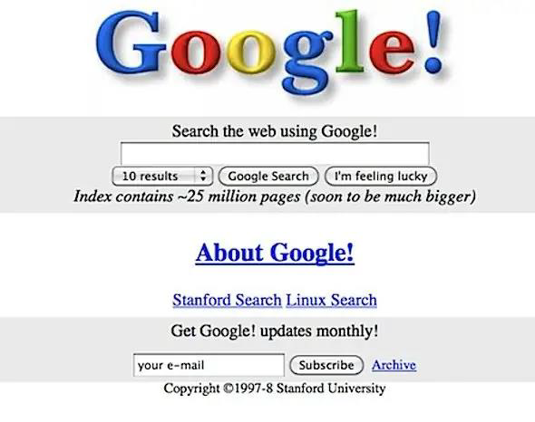
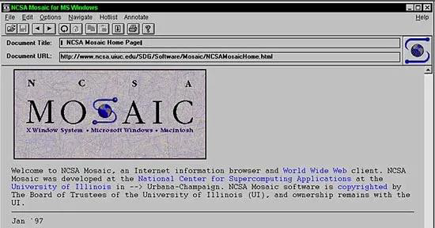
History of HTML
Amazon (1995)
Yahoo (1994)
Google (1998)
eBay (1995)

Slide 16
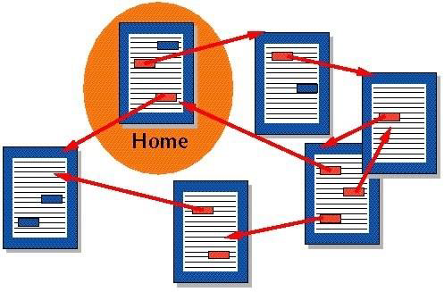
What is HTML?
Hyper-Text Markup Language (HTML)
Hyper-Text – a document with hyperlinks (references) to other documents
Markup – a system (set of tags) of text annotation to control its structure, formatting and relationships between its parts
MS Word: Bold Text
Markdown: ** Bold Text **
LaTeX: \textbf{ Bold Text }
HTML: <strong> Bold Text </strong>
WhatsApp: *Bold text*
Language – a structured system of communication with its alphabet, vocabulary and a grammar (specific set of rules)

Slide 17
HTML Document
What is a HTML document?
Text file with an extension “.htm” or “.html”
Can be created in a text editor: Notepad, TextEdit, Sublime, VS Code, WebStorm
Contains markup tags (elements) which direct how a page is to be displayed by browsers
Must have proper text encoding (UTF-8)
HTML is not case sensitive (head = HEAD)
Example: index.html
<!DOCTYPE html>
<html>
<head>
<meta charset="UTF-8">
<title>My Website</title>
</head>
<body>
<h1>Hello, World!</h1>
</body>
</html>

Slide 18
HTML Document
HTML document consists of elements
DOCTYPE – type of document
<!DOCTYPE html> - stands for HTML5
html – root element of a HTML document
head – section for meta information
(encoding, display settings, other resources)
title – title of a document, shown in browser’s Tab
body – section for main content of a webpage
h1 – defines a heading (h1-h6)
p – defines a paragraph
<!DOCTYPE html>
<html>
<head>
<meta charset="UTF-8">
<title>My Website</title>
</head>
<body>
<h1>Hello, World!</h1>
<p>Some paragraph</p>
</body>
</html>

Slide 19
HTML Elements
HTML elements must follow specific structure and rules to be correctly processed and shown in browsers
Elements consist of opening tag, content and closing tags (except for some elements):
<h1>Hello, World!</h1> - no spaces after < and </
<hr>, <br> <meta> - no closing tags, no content
Elements must be correctly nested
CORRECT: <body> <h1> Hello, World! </h1> </body>
WRONG: <body> <h1> Hello, World! </body> </h1>
Special element for comments: <!--Browsers don’t show this content -->

Slide 20
HTML Attributes
Elements may have attributes that come in name="value” pairs
<meta charset="UTF-8">
Attributes provide additional information about elements
Attributes are always specified in the opening tag
<h1 title="I'm a header"> Hello, World! </h1>
Attribute values must be in quotes (single or double)

Slide 21
H1 vs. Div
H1 tag
Needs to reflect the content of the page
Helps SEO (Search Engine Optimization)
DIV tag
Block-level element – universal tag
Can be styled with CSS to look like any other element
Mostly used with class and id attributes as in my.nu.edu.kz

Slide 22
Semantic tags
Semantic elements’ name imply some meaning to the content
Human/machines can better understand the structure of a document
Some useful tags:
header, footer
nav
section, article, aside
1.html

Slide 23
Links
Fragment links
<a href="#some_element_name">Page Fragment</a>
<div id="some_element_name">…</div>
Internal links
<a href="some_page.html">Some internal page</a>
External links
<a href="http://w3.org">Some external link</a>
Image links
<a href="http://w3.org"><img src="w3.org.png" width="50px"></a>
Email links
<a href="mailto:email">Email link</a>
1.html

Slide 24
Links
Use target attribute of <a> tag to:
open in the new window
<a href="some_url" target="_blank">….</a>
open in the current window
<a href="some_url" target="_self">….</a>
1.html

Slide 25
Menu
To create a menu for a website use:
semantic tag <nav> to wrap menu items
unordered list to wrap each menu item
apply CSS and JS to style a menu (later)
<nav>
<ul>
<li><a href="1.html">Menu Item 1</a></li>
<li><a href="2.html">Menu Item 2</a></li>
<li><a href="3.html">Menu Item 3</a></li>
</ul>
</nav>
1.html

Slide 26
Displaying Images
Some useful notes on <img> tag
remember that <img> is an inline element
use src attribute is similar to href attribute
the attribute alt is required for visually impaired people
use width and height attributes to allocate space on the page
Images can be used as links (as logo)
<a href="http://w3.org"><img src="w3.org.png" width="50px"></a><br>
2.html

Slide 27
Escape characters
There are 3 main characters to be escaped:
use &lt; to escape < symbol
use &gt; to escape > symbol
use &amp; to escape & symbol
Useful escape symbols:
&quot; - to make a quotation
&nbsp; - non-breaking space
&copy; – copyright symbol
2.html

Slide 28
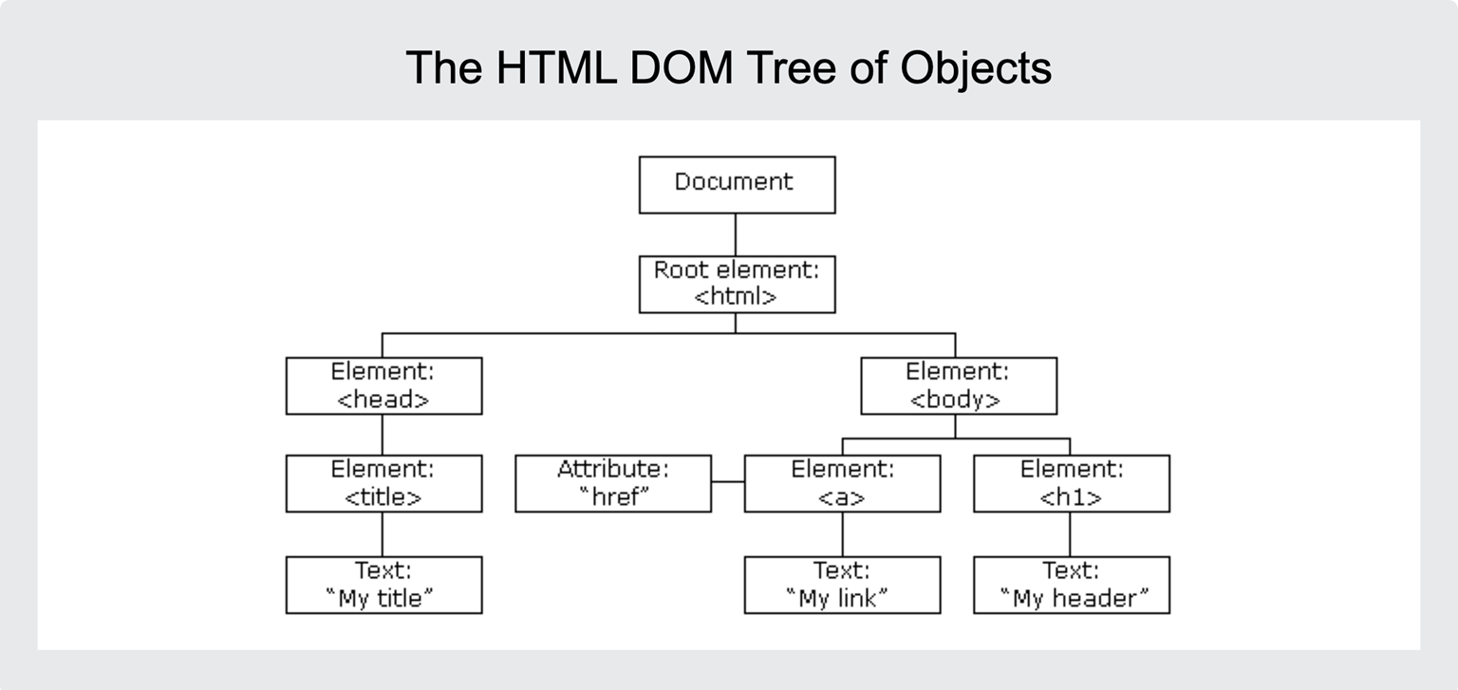
Document Object Model
When a web page is loaded, the browser creates a Document Object Model (DOM) of the page.
The HTML DOM model is constructed as a Tree of Objects.
HTML Elements can be found and accessed with JavaScript:
Finding elements by id
Finding elements by tag name
Finding elements by class name
Finding elements by CSS selectors

Slide 29
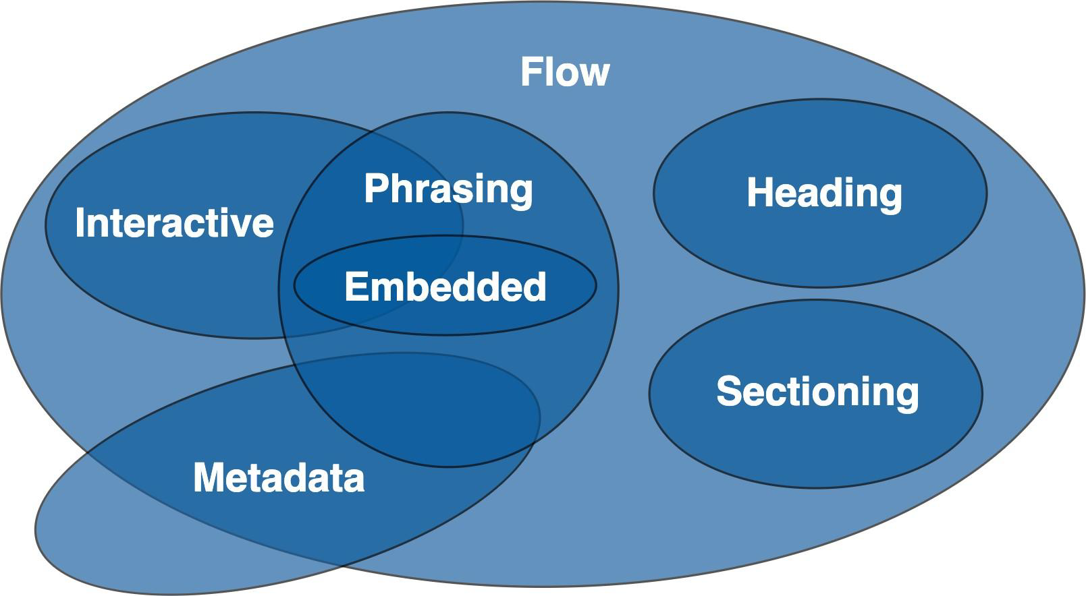
HTML Content Model
Each element in HTML falls into zero or more categories that group elements with similar characteristics together:
• Metadata content
• Flow content
• Sectioning content
• Heading content
• Phrasing content
• Embedded content
• Interactive content
https://www.w3.org/TR/2011/WD-html5-20110525/content-models.html#content-models

Slide 30
HTML Content Model
Inline elements
• Placed on the same line line (by default)
• May include only other inline elements
• Roughly corresponds to Phrasing content
• eg.: span, strong, a
Block-level elements
• Placed on a new line (by default)
• Occupies full width of the line
• May include other block-level or inline elements
• Roughly corresponds to Flow content
• eg.: h1, div, p, ul, ol
https://www.w3schools.com/html/html_blocks.asp

Slide 31
Summary
Web technology (frontend) is based on HTML 5, CSS 3 and JavaScript 6
HTML Documents are specially written text files and have html extension
HTML elements and attributes direct browsers how to display a web page
Use h1 tag for a page to convey the topic of the content
Use semantic tags whenever possible to improve your SEO
Use different types of links for your needs
Use unordered lists for menu items
Use width and height attributes of <img> tag accurately
Use escape character not to break your HTML code
Document Object Model is a tree like structure associated with HTML document
self-study:
https://www.w3schools.com/html/default.asp

Slide 32
Thanks for Attention!

